Slide 1
Innovative Monitoring System for TeleICU Patient Using Video Processing & Deep Learning

Slide 2
PROBLEM STATEMENT
Detection of Precursors to Patient Deterioration: Creation of algorithms that can identify early signs indicating subtle health changes for patients using video data, so as to a) decrease the occurrence adverse events and b) improve patient outcomes in TeleICU settings.
Video Analytics Integrated with Clinical Decision Support: Combines advanced video processing capabilities with clinical decision support systems to provide actionable insights and recommendations for healthcare provider teams, improving the efficiency and effectiveness of TeleICU care solutions.
Continuous Monitoring Video Analysis Tool Compliant to Privacy Need: Design assistive tools for privacy-preserving video analysis in TeleICU environments that maintain patient confidentiality while performing continuous monitoring of vital signs, behaviors and activity patterns.

Slide 3
UNIQUE IDEA BRIEF(SOLUTION)
Detailed Solution:
This ground-breaking monitoring system uses high-definition video cameras positioned around TeleICU rooms to record patient engagements and vital statistics. The company says the system employs deep learning algorithms to review video streams around the clock and keep an eye out for small signals in shifts in patient behavior, facial expressions or how people move about.
Key points
Behavior Analysis and Mood Detection: The patient interesting behaviors which might indicate a mood change, discomfort or distress) are collected by deep learning model to Analyze the behavior of CHF patients [Fig. These are characteristics like both the face Recognition for assessing pain and analyzing activity levels and mobility recording movements.
With Predictive Analytics To Aid In Early Intervention: The predictive analytics model predicts any possible health deterioration based on similar trends in historical data as well as real-time observations. They preemptively generate early warning alerts to alert health care providers *before* an issue, allowing the provider sufficient time for proactive intervention before it becomes a crisis.

Slide 4
FEATURES OFFERED
Monitoring vital signs in real-time;
Description: Real-time monitoring of physiological signs, such as heart rate and respiratory rate limb movement to oxygen saturation from a video signal.
Avail: Real-time, nonobtrusive health status monitoring with ability of early intervention and no invasive sensors
Behavioral Analysis & Track Activity:
Summary: A video analytics to parse the routines, activity and patterns of patient.
Benefit: This helps to measure the patient comfortability, pain scale, daily activities and there are several planning can be done for personalized care by this aid.
Recognition of Pain Using Facial Recognition techniques:
Title : Automated pain assessment using a facial recognition software characterized with local imaging features in rendered wand face images.
Benifit: more accurate pain assessment and objective medic ation-humongously inpatient comfort.

Slide 5
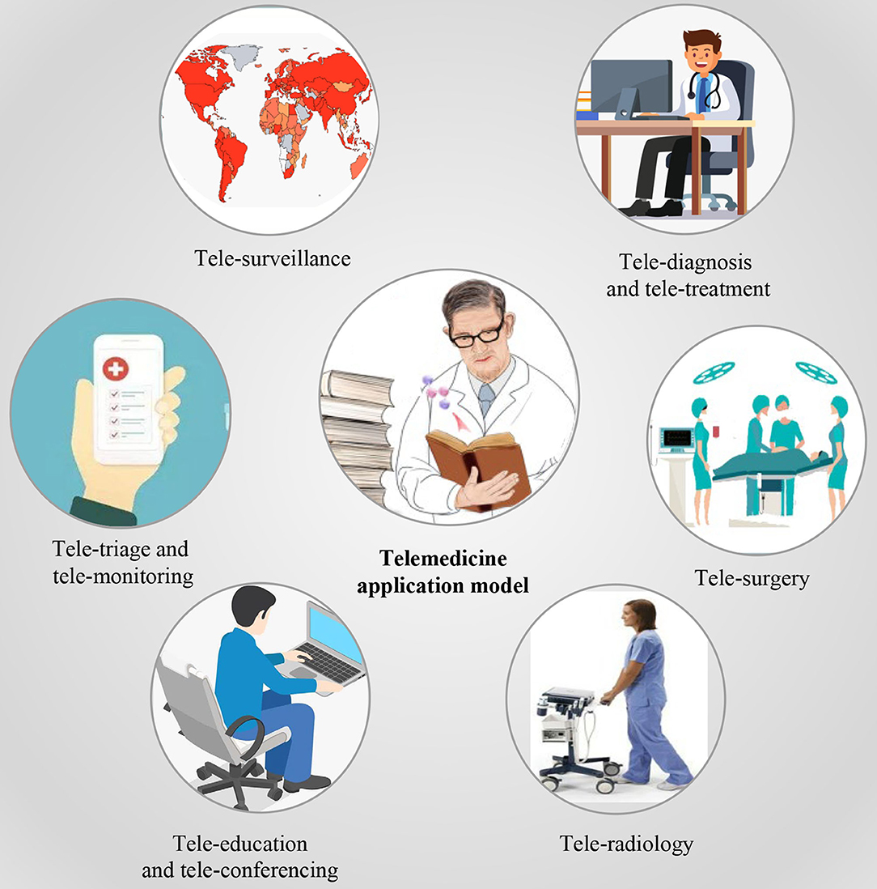
PROCESS FLOW

Slide 6
ARCHITECTURE
Input
Pre-processing of frames
Server Processing Unit
Stream of Video
Person Type Detection
ROI Setting
Motion Detection
Action Handler
Web Notification
Storing Data
Control Center
Event Triggered

Slide 7
TECHNOLOGY USED
ANACONDA:
Anaconda is a popular open-source distribution of Python and R programming languages for data science, machine learning, and scientific computing. It simplifies package management and deployment by providing a comprehensive ecosystem of tools and libraries that are pre-installed and optimized for performance.
SPYDER:
Spyder is an open-source integrated development environment (IDE) specifically designed for scientific computing, data analysis, and numerical computing using Python. It is well-suited for tasks such as data exploration, data visualization, and rapid prototyping of scientific algorithms.

Slide 8

TEAM GUIDE:
NAME | DR.JAGADHEESH | PICTURE
G-MAIL | jagadishmalipatil@gmail.com
CONTACT NO. | 9036511203
CONTRIBUTION | Guide and mentor

Slide 9

TEAM MEMBER 1:
NAME | SHASHANK MARBE | PICTURE
G-MAIL | shashankmarbe6@gmail.com
CONTACT NO. | 7411731532
CONTRIBUTION | Code development

Slide 10
TEAM MEMBER 2:
NAME | SHRINATH BIRADAR
G-MAIL | biradarshrinath5@gmail.com
CONTACT NO. | 8867355847
CONTRIBUTION | Code development

Slide 11
TEAM MEMBER 3:
NAME | SIDDARAM
G-MAIL | patilsiddaram276@gamil.com
CONTACT NO. | 9900587044
CONTRIBUTION | Code analyzer

Slide 12
TEAM MEMBER 4:
NAME | VINAY KUMAR
G-MAIL | kumarkumar84972@gamil.com
CONTACT NO. | 8296704017
CONTRIBUTION | Code analyzer

Slide 13
CONCLUSION
The project is detecting the type of person and motion of person and integrating it to the event handler which will notify on the screen of control center. The project will be expanded to the type of motions that patient will be making and segregating according to the motions and alarming intensivist according to the severity.

Slide 14
THANK YOU

